Slide 1
Documentary Requirements on the Purchase of Real Property
- Land
- Structure/House
- Tree, Plants, Growing Fruits, etc
Assistant Commissioner ALEXANDER B. JULIANO
Local Government Audit Sector

Slide 2
The Commission on Audit
Constitutional and Statutory Basis
Section 2, Article IX-D, 1987 Constitution
Presidential Decree No. 1445, otherwise known as the “Government Auditing Code of the Philippines”
Executive Order No. 292 or the “Administrative Code of 1987”

Slide 3
Sec. 2, Article IX-D, 1987 Philippine Constitution
COA has the power, authority, and duty to examine, audit, and settle all accounts pertaining to the revenue and receipts of, and expenditures or uses of funds and property​
Exclusive authority, subject to the limitation in this Article, to define the scope of its audit and examination, establish the techniques and methods required therefor.​
Prevention and disallowance of irregular, unnecessary, excessive, extravagant, or unconscionable expenditures or uses of government funds and properties​

Slide 4
Authority to Promulgate Auditing and Accounting Rules
Article IX-D, 1987 Constitution
Section 2(2)
X x x, and promulgate accounting and auditing rules and regulations x x x.
PD 1445
Section 25 (4), Chapter 2
To promulgate auditing and accounting rules and regulations so as to facilitate the keeping, and enhance the information value, of the accounts of the government
Section 33
The Commission shall promulgate such auditing and accounting rules and regulations as shall prevent irregular, unnecessary, excessive, or extravagant expenditures or uses of government funds or property.

Slide 5
COA Issuances:
Documentary requirements for common government transactions

Slide 6
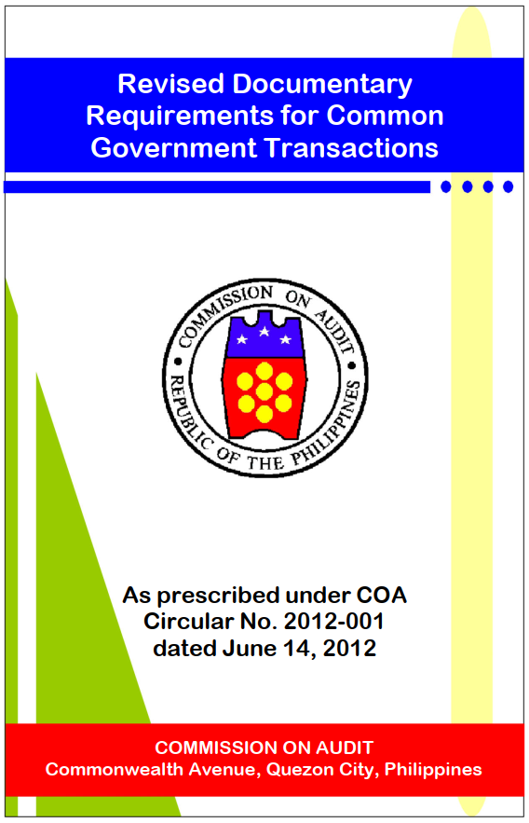
COA Circular No. 2012-001 June 14, 2012
Prescribing the Revised Guidelines and Documentary Requirements for Common Government Transactions

Slide 7
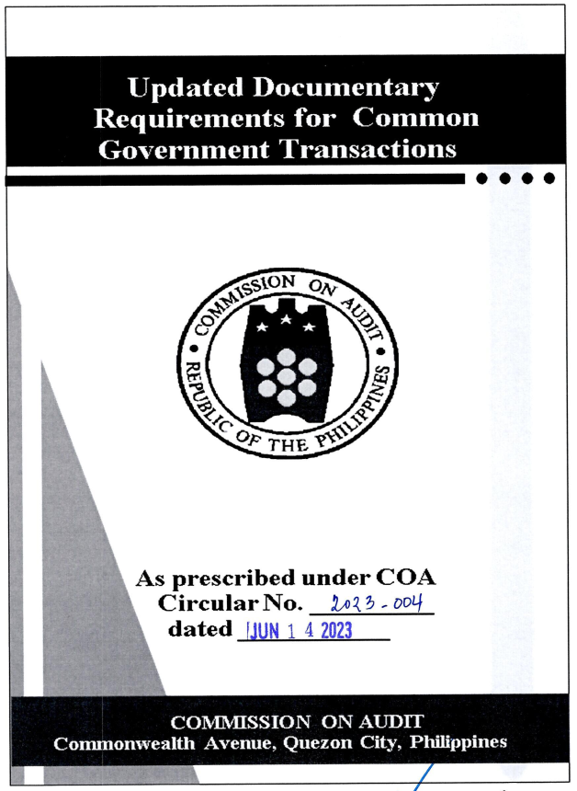
COA Circular No. 2023-004 dated June 14, 2023
Prescribing the Updated Documentary Requirements for Common Government Transactions, amending COA Circular No. 2012-001 dated June 14, 2012

Slide 8
COA Circular No. 2024-004 dated March 14, 2024
  Suspended the application of COA Circular No. 2023-004, retroactive to its effectivity on July 1, 2023
  Reinstated COA Circular No. 2012-001
Notes:
COA Circular No. 2023-004 dated June 14, 2023 was issued to prescribe the updated documentary requirements for common government transactions to facilitate disbursement, liquidation and audit thereof. The said Circular took effect 15 days after its publication I in a newspaper of general circulation, or on July 1, 2023.
However, due to the numerous issues and concerns raised relative to the updated documentary requirements, there is a need to suspend the application of COA Circular No. 2023-004 pending the issuance of revised guidelines addressing the said issues and concerns.

Slide 9
COA Circular No. 2024-004 dated March 14, 2024
  Any audit action issued by the COA Audit Team which was based on COA Circular No. 2023-004 is deemed withdrawn and has no force or effect, except the audit action is based on the provisions which were copied and lifted from COA Circular No. 2012-001
Notes:
COA Circular No. 2023-004 dated June 14, 2023 was issued to prescribe the updated documentary requirements for common government transactions to facilitate disbursement, liquidation and audit thereof. The said Circular took effect 15 days after its publication I in a newspaper of general circulation, or on July 1, 2023.
However, due to the numerous issues and concerns raised relative to the updated documentary requirements, there is a need to suspend the application of COA Circular No. 2023-004 pending the issuance of revised guidelines addressing the said issues and concerns.

Slide 10
Revised Documentary Requirement for Common Gov’t Transactions
Fundamental Principles under Section 4 of PD No. 1445
No money shall be paid out of any public treasury or depository except in pursuance of an appropriation law or other specific statutory authority.
Government funds or property shall be spent or used solely for public purposes.
Trust funds shall be available and may be spent only for the specific purpose for which the trust was created or the funds received.
Notes:
Section 4. Fundamental principles. Financial transactions and operations of any government agency shall be governed by the fundamental principles set forth hereunder, to wit:

Slide 11
Revised Documentary Requirement for Common Gov’t Transactions
Fundamental Principles under Section 4 of PD No. 1445
Fiscal responsibility shall, to the greatest extent, be shared by all those exercising authority over the financial affairs, transactions, and operations of the government agency.
Disbursements or disposition of government funds or property shall invariably bear the approval of the proper officials.
Claims against government funds shall be supported with complete documentation.
All laws and regulations applicable to financial transactions shall be faithfully adhered to.
Notes:
Section 4. Fundamental principles. Financial transactions and operations of any government agency shall be governed by the fundamental principles set forth hereunder, to wit:

Slide 12
Revised Documentary Requirement for Common Gov’t Transactions
Fundamental Principles under Section 4 of PD No. 1445
Generally accepted accounting principles and practices as well as of sound management and fiscal administration shall be observed, provided that they do not contravene existing laws and regulations.
Notes:
Section 4. Fundamental principles. Financial transactions and operations of any government agency shall be governed by the fundamental principles set forth hereunder, to wit:

Slide 13
Revised Documentary Requirement for Common Gov’t Transactions
General Requirements for All Types of Disbursement
Certificate of Availability of Funds issued by the Chief Accountant
Existence of lawful and sufficient allotment duly obligated as certified by authorized officials [except for government-owned and controlled corporations/government financing institutions (GOCCs/GFIs)]
Legality of transaction and conformity with laws, rules or regulations
Approval of expenditure by Head of Office or his authorized representative
Sufficient and relevant documents to establish validity of claim

Slide 14
Documentary requirements for common government transactions (coa Circular No. 2012-001)
- Land
- Structure/House
- Tree, Plants, Growing Fruits, etc

Slide 15
Revised Documentary Requirement for Common Gov’t Transactions
13.0 Road Right-of-Way (ROW)/Real Property
Claims for road right-of-way are subject to the provisions of RA No. 8974 and its IRR.
RA No. 8974 - An Act To Facilitate The Acquisition Of Right-of-way, Site Or Location For National Government Infrastructure Projects And For Other Purposes

Slide 16
Revised Documentary Requirement for Common Gov’t Transactions
13.1 Land
Documentary Requirements common to both Negotiated Purchase and Payment by Court Decision
Project parcellary survey plan showing that said lot and structures are within the boundaries of the right-of-way
Structural Mapping Plan of the lot affected
Certification by the implementing agency that the claim is not within the original ROW of a converted local road
Certification from the Head of the Implementing Office that there is no previous pending claim and previous payment on subject property

Slide 17
Revised Documentary Requirement for Common Gov’t Transactions
13.1 Land
Documentary Requirements common to both Negotiated Purchase and Payment by Court Decision
Environmental Clearance Certificate (ECC) as required under Section 8 of RA No. 8974
Copy of latest updated master list of Project-Affected-Persons (PAP) approved by Agency’s authorized representative
In case of death of claimant or owner, judicial settlement duly advertised in a newspaper of general circulation

Slide 18
Revised Documentary Requirement for Common Gov’t Transactions
13.1 Land
Additional Documentary Requirements
For Negotiated Purchase
Independent Appraisal Report/Regional Committee Resolution indicating the valuation of the land. Valuation should be based on the provisions of RA No. 8974
Applicable BIR Zonal Valuation
Certified Photocopy of Authority/Agency Resolution to Purchase Land or Land Rights indicating the approved/established valuations or BIR Zonal Valuations
Deed of Absolute Sale registered with the Register of Deeds where the land is located

Slide 19
Revised Documentary Requirement for Common Gov’t Transactions
13.1 Land
Additional Documentary Requirements
For Negotiated Purchase
Certified Photocopy of Tax Clearance from Assessor’s Office where the land is located
  Certificate Authorizing Registration (CAR)
  Capital Gains Tax (CGT)
  Documentary Stamp Tax (DST)
  Transfer Tax

Slide 20
Revised Documentary Requirement for Common Gov’t Transactions
13.1 Land
Additional Documentary Requirements
If registered land:
If whole lot is acquired, Transfer Certificate of Title (TCT) Certificate of Land Ownership Award/Original Certificate Title/Emancipation Patent (CLOA/OCT/EP) certified as true copy by the Register of Deeds and Tax Declaration (TD) certified as true copy by the Assessor’s Office in the name of the procuring entity or previous owner depending on the provisions of the sale
If portion of lot is acquired, certified photocopy of TCT and TD in the name of the procuring entity or previous owner with annotation of sale

Slide 21
Revised Documentary Requirement for Common Gov’t Transactions
13.1 Land
Additional Documentary Requirements
If unregistered land:
Certified photocopy of TD in the name of the procuring entity or previous owner with annotation of sale
Notarized Affidavit of Ownership
Certification from the City/Municipal Treasurer that the claimant is the sole entity paying the taxes for the property for the past five years
Notarized joint affidavit of two adjoining landowners or Barangay/Local Officials concerned attesting to the ownership of land

Slide 22
Revised Documentary Requirement for Common Gov’t Transactions
13.1 Land
Additional Documentary Requirements
If unregistered land:
Such other documents deemed necessary for the auditorial review and in the technical evaluation thereof
If claim for payment or amount of sale exceeds P50,000 (EO No. 1035), certified photocopy of Claimant’s Surety/Indemnity Bond issued by any Insurance Company duly accredited by the Insurance Commission

Slide 23
Revised Documentary Requirement for Common Gov’t Transactions
13.1 Land
Additional Documentary Requirements
For payment of Court Decision:
Certified photocopy of Court Decision registered with the Register of Deeds where the land is located including all annexes referred to in the court decision
Certified true copy of TCT for registered land, and TD in the name of the previous owner for unregistered land with court decision duly annotated
Certificate of Finality of Decision

Slide 24
Revised Documentary Requirement for Common Gov’t Transactions
13.2 Structure/House
Documentary Requirements
Approved and Notarized Agreement to Demolish and Remove Improvements (ADRI) / Notarized voluntary undertaking to vacate the project area
Sketch plan/drawing of house/structure
Notarized landowner’s waiver of rights/quitclaim to affected houses/structures or establishments if payment will be made to claimants other than the owner
Pictures of the structures before, during and after the demolition

Slide 25
Revised Documentary Requirement for Common Gov’t Transactions
13.2 Structure/House
Documentary Requirements
Certified true copy of owner’s identification (ID), Residence Certificate and Barangay Clearance
Computation of Replacement Cost duly approved by implementing Office Director supported with current abstract of canvass of construction materials
Certificate of Total Demolition
Map showing the location of the structure/house in the project-affected area

Slide 26
Revised Documentary Requirement for Common Gov’t Transactions
13.2 Structure/House
Documentary Requirements
Notarized affidavit of ownership with Waiver or Right/Quitclaim to affected house/structure
Copy of masterlist of Project-Affected-Persons (PAPs) indicating the names of affected house/structure owners approved by authorized personnel
Certified photocopy of title (TCT/OCT or CLOA/EP) and TD of land where the house/structure is erected

Slide 27
Revised Documentary Requirement for Common Gov’t Transactions
13.3 Improvements (trees, plants, growing fruits, etc)
Documentary Requirements
Permit issued by the Department of Environment and Natural Resources (DENR) to cut plants, forest tress and fruit bearing trees on areas affected by the project.
Affected Trees/Crops Inventory duly certified by the Agency’s Project Committee/Authorized Officer and showing among others the following: lot number as indicated in the project plan, number of items, specifies classification, diameter, height, lot owner, owner of trees/plants/crops and price
Quitclaim or Waiver issued by the lot owner if he is not the claimant

Slide 28
Revised Documentary Requirement for Common Gov’t Transactions
13.3 Improvements (trees, plants, growing fruits, etc)
Documentary Requirements
Map/sketch plan showing the location of the improvement in the project affected area
Resolution/approval of valuation of damaged improvement
Copy of the approved valuation of crops, plants and trees issued by concerned government agency
Notarized Affidavit of Ownership with Right/Quitclaim to affected improvements
Copy of the latest updated masterlist of PAPs approved by proper authorities

Slide 29
Revised Documentary Requirement for Common Gov’t Transactions
13.3 Improvements (trees, plants, growing fruits, etc)
Documentary Requirements
If registered land:
Certified true copy of title (TCT/OCT or CLOA/EP)
If unregistered land:
  Certified photocopy of TD
  Notarized joint affidavit of two adjoining landowners or barangay/local officials concerned attesting to the ownership of land

Slide 30
Revised Documentary Requirement for Common Gov’t Transactions
13.3 Improvements (trees, plants, growing fruits, etc)
Documentary Requirements
If payment through Court Decision
  Certified photocopy of Court Decisions (Final Order/Decision or Certificate of Finality of Decision)

Slide 31
Updated documentary requirements for common government expenditures
Notes:
In the works!
The use of digital technologies has significantly changed the way government agencies conduct business transactions, especially with electronic collections and payments.
Accordingly, the Permanent Review Committee (PRC) was reconstituted under COA Office Order No. 2024-034 dated January 17, 2024 to address the issues and concerns raised by stakeholders on the revised Circular and consider new laws, regulations and other related issuances
COA Circular No. 2012-001 shall remain in force until the issuance and effectivity of the Updated Documentary Requirements for Common Government Expenditures

Slide 32
Thank you!

